Slide 1

DriverPass System Analysis
Sergio Mateos
Notes:
[No speaker notes required for this slide.]

Slide 2

System Requirements
The system shall confirm the information to register (Full Name, address, payment information, phone number, package).
The system shall update any changes from the DMV.
The system shall notify customers if their account is accessed from an unknown device.
The system shall allow access to information based on their role in DrivinPass
The system shall allow customers to reset their passwords
Notes:
[In your speaker notes, include an explanation of the different requirements you determined for DriverPass’s system. What are the functional requirements you selected to describe? What are the nonfunctional requirements you selected to describe? Be sure to explain how these requirements meet DriverPass’s needs.]

Slide 3
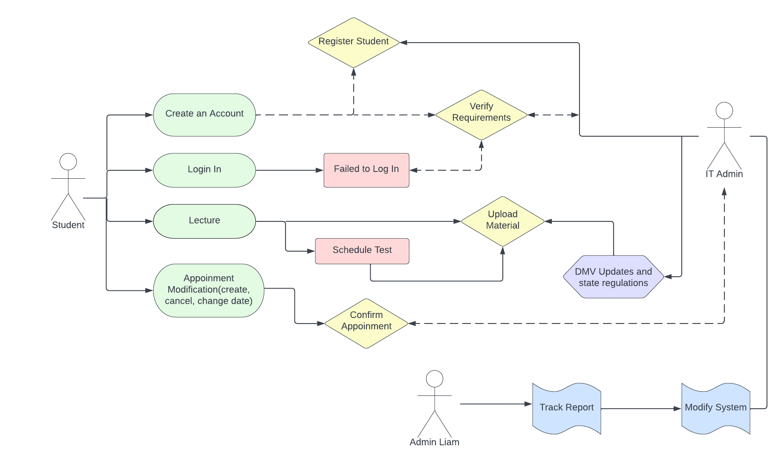
Use Case Diagram
Notes:
[Explain your diagram. Who are the different actors in the system? What are the different use cases? How did you account for DriverPass’s needs in your design? In your explanation, keep your audience in mind. Avoid the use of terms like “actors” and “use cases” in your explanation.]

Slide 4
UML Use Case Diagram
The UML Use Case Diagram is a representation of how the role of “Student” (user), “IT Admin” (this includes secretary, drive professor, and server), and “Project Owner” or “Admin” (Liam). The UML shows the role and the action of each actor interacting with the other.

Slide 5
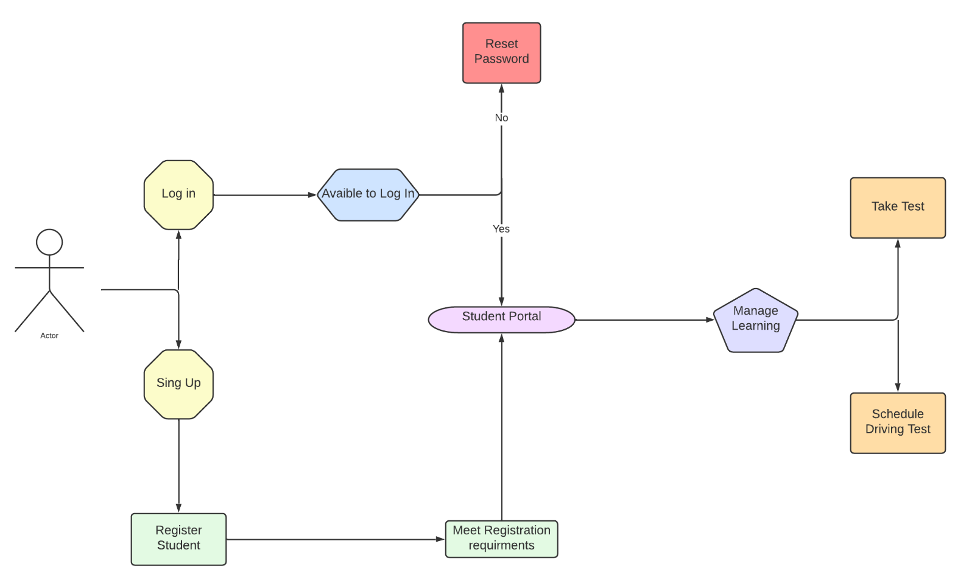
Activity Diagram
Notes:
[Explain your diagram. Which use case are you breaking down? What are the steps for this use case? How did you account for DriverPass’s needs in your design? In your explanation, keep your audience in mind. Avoid the use of technical terms such as “nodes,” “control flows,” and so on.]

Slide 6
UML Activity Diagram
The UML Activity Diagram is the representation of how the student interacts with the platform from the begging which would start on the login/sign-up and finish when the student is available to take test and schedule a driving test.

Slide 7
Security
Customers are required to have a unique username and password to secure their accounts
The use of HTTP will secure the connection, preventing data exchange between the customer and the server
Aware customers when they are using suspicious networks to prevent a data leak
Customers will have a certain number of attempts to log in (4 attempts), after that, the customers will be notifying the issue and asked for authentication proof like Secured Questions, Phone Number Pin (send via text message), or email verification code (send via the email address)
Notes:
[How did you consider security in your design? In your explanation, keep your audience in mind by avoiding the use of technical terms.]

Slide 8
System Limitations
Customers will be limited if their hardware does not have enough capability to implement the app or website
The customers will need to have a certain amount of time each week and the required capital to purchase at least the cheapest package
The system would be limited capability if the internet connection is low
The project has a strict time limit
The project owner does not specify a budget to work around it
Notes:
[What are the limitations of your design? In your explanation, keep your audience in mind by avoiding the use of technical terms.]

